Slide 1
19CSE-461- NetCentric Programming Session-2
Dr.T.Senthil Kumar/Dr.S.Thangavelu/Dr.C.Arun Kumar

Slide 2
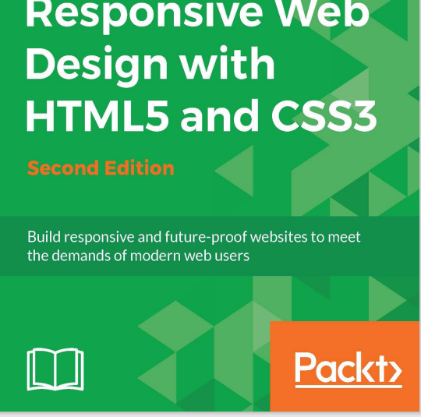
Agenda
Responsive Web Design
Basics
Viewports
CSS Extensions
Responsive Web Designs
Chapter 2

Slide 3
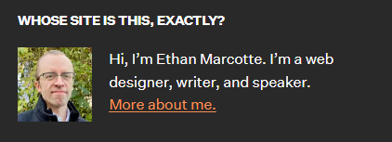
Responsive Web Design
Ethan Marcotte in 2010 …
1. In his seminal A List Apart article
http://www.alistapart.com/articles/responsiveweb-design/),
he consolidated three existing techniques (flexible grid layout, flexible images/media, and media queries) into one unified approach and named it responsive web design !!!
2.Content could fix to all type of screens
2. Processes evolved and it became apparent that everything from design, to content and development, worked much better when working in the opposite direction; starting with smaller screens and working up.

Slide 4
Requirements for responsive web design
The number of handheld devices operating worldwide is growing exponentially. According to stats, more than 90% of adults own a cell phone
The deal is, in the late 2000s, serving information for users was a piece of cake. You just needed several versions of the same website: one for mobile phones, the other one for desktops. However, in the 2020’s we cannot commit to supporting each new user agent with its own bespoke experience since each year, we witness new dimensions and screen sizes.
Creating styles for each screen size is time-consuming, resource-consuming, and expensive.
Even if you manage to cover all the breakpoints in the World, this will seriously overload the website and ipso facto decrease performance that drastically worsens conversions and user’s engagement with the brand
So, how can entrepreneurs avoid this fate and successfully meet the fast-changing realms of digital expanses? The answer is simple – adopt responsive design.
Investing in a website whose pages are responsive and accessible, regardless of the browser, platform, or screen that your reader must use to access, is the only way to stay afloat these days. Responsive web design is no longer a tendency; it is a standard that we need to enforce to make the web a better place.

Slide 5
Benefits
The main benefits of using a responsive website are
consistent visual experience;
better user experience;
no need for redirects;
lower bounce rates;
lower maintenance needs;
high web page loading speed;
no extra fees for creating and maintaining different versions;
easy analytics reporting.
Even though responsive design is not flawless, it has its cons, for example,
It is not fully optimized;
It can slow performance;
It may suffer from web browser incompatibility;
It makes it challenging to run advertising campaigns;
It makes it challenging to offer different things to different users depending on the device used;

Slide 6
How does it work?
The idea behind responsive web design lies in building a flexible website whose content and design behave like water that fills the container, aka a device that customers use to visit the website. All elements of the website undergo changes to feel comfortable inside the screen. If it is necessary, they shrink to perfectly fit into smaller spaces or, on the contrary, stretch to occupy every inch of space. Everything scales up or down automatically to match the device.
A responsive website’s key point is to understand that its primary task is to provide a comfortable user experience for anyone. This requires ensuring good readability, proper visual experience, a certain level of accessibility, as well as maintaining consistent functionality from device to device.
In practice, responsive web design works through CSS and sometimes JavaScript plugins to cope efficiently with screen size, orientation, resolution, color capability, and other user’s device characteristics. The most popular CSS properties that help realize responsive web design are the viewport and media queries.

Slide 7
Setting browser support levels
Enhanced visuals and capabilities for more capable browsers
Approaches :
progressive enhancement –
'base level' experience and enhancing is easier than coming at the problem from the opposite direction
graceful degradation
-building the ultimate experience first then attempting to provide fall backs for less capable platforms
if the cost of developing and supporting browser X is more than the revenue/benefit created by the users on browser X; don't develop specific solutions for browser X.

Slide 8
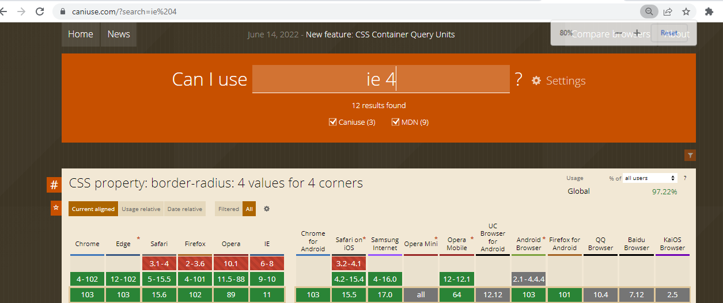
Try caniuse.com

Slide 9
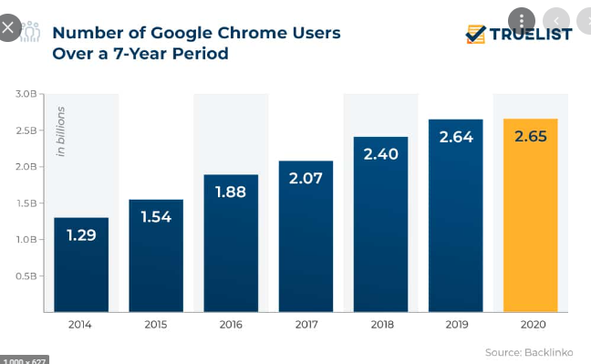
Refer:
https://www.ukwebhostreview.com/web-browser-statistics/

Slide 10
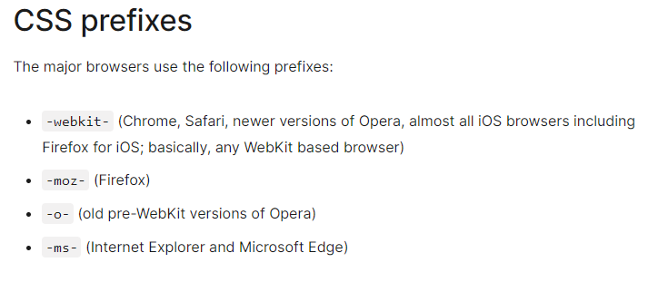
Tooling and text editors
Vendor Prefix
Need is something that enables you to write HTML, CSS, and JavaScript.
It can be Sublime Text, Vim, Coda, Visual Studio, or Notepad
CSS processors (Sass, LESS, Stylus, PostCSS) can help with code organization, variables, color manipulations, and arithmetic.
Tools like PostCSS can also automate horrible and thankless jobs like CSS vendor prefixing.
Furthermore, 'Linting' and validation tools can check your HTML, JavaScript, and CSS code against standards as you work, eliminating many time wasting typos or syntax errors
Browser vendors sometimes add prefixes to experimental or nonstandard CSS properties and JavaScript APIs, so developers can experiment with new ideas while—in theory—preventing their experiments from being relied upon and then breaking web developers' code during the standardization process.
Developers should wait to include the unprefixed property until browser behavior is standardized.
Refer : https://developer.mozilla.org/en-US/docs/Glossary/Vendor_Prefix

Slide 11
Code Repository
You can download all the code samples from this book by visiting rwd.education/download.zip or via GitHub at https://github.com/benfrain/rwd.
Text Book Code sample is also uploaded for additional reference

Slide 12
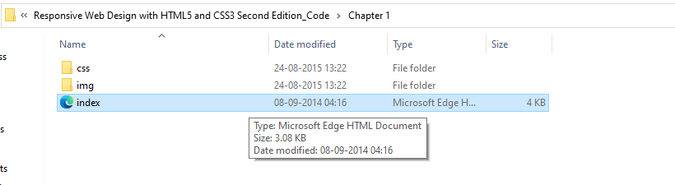
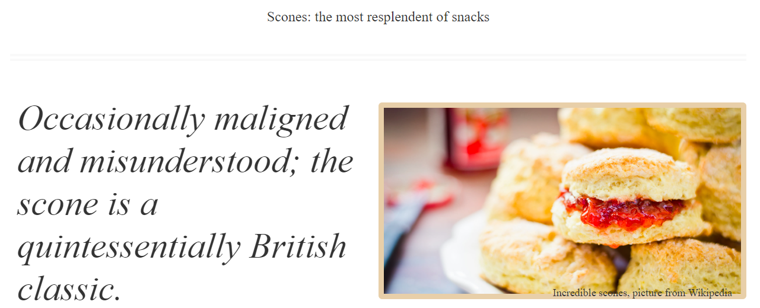

Slide 13
HTML 5
The viewport is the user's visible area of a web page.
The viewport varies with the device, and will be smaller on a mobile phone than on a computer screen.
Before tablets and mobile phones, web pages were designed only for computer screens, and it was common for web pages to have a static design and a fixed size.

Slide 14
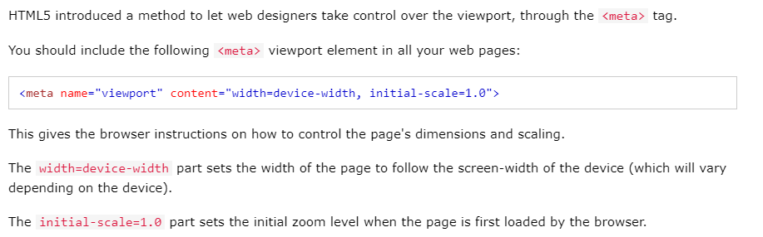
Setting the view port

Slide 15
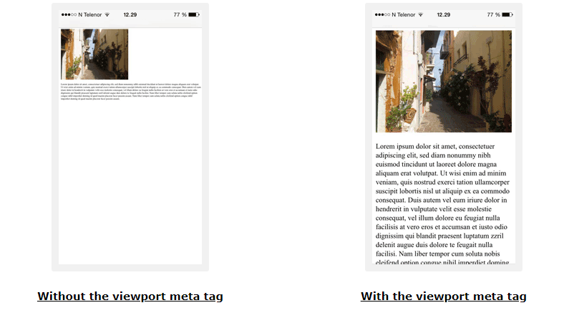

Slide 16
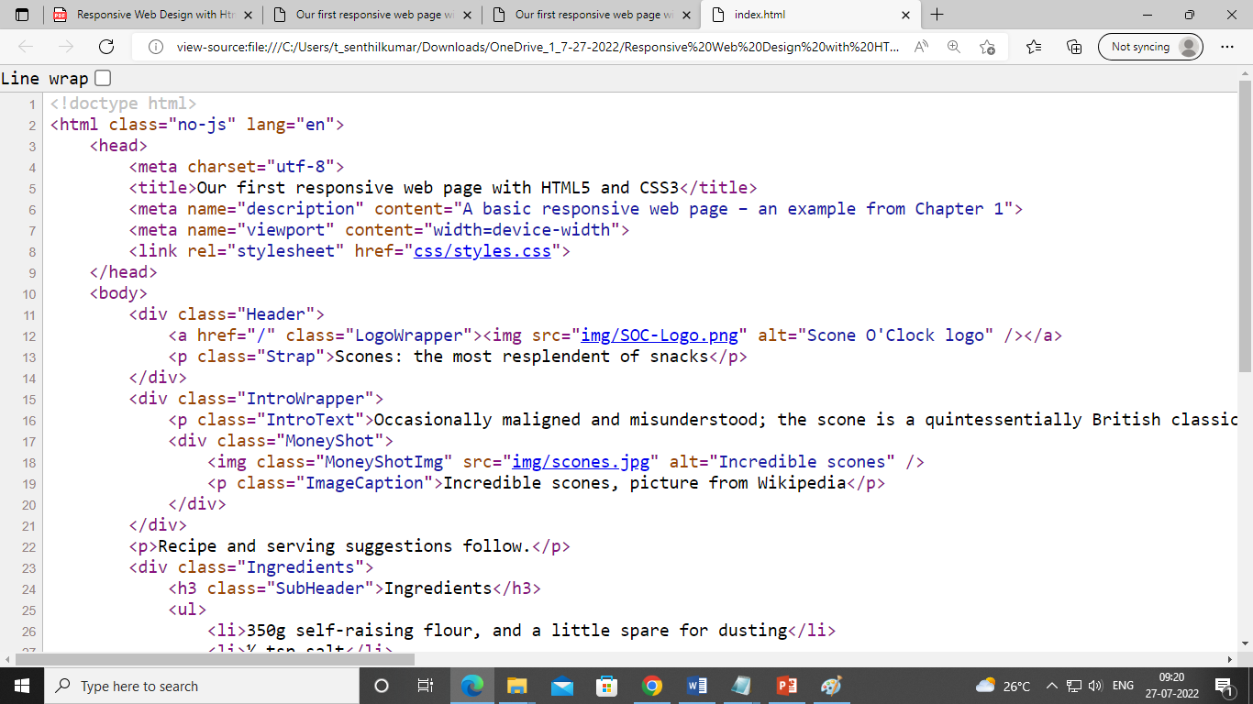
The viewable area of a browser is known technically as the viewport.
The viewport is seldom equivalent to the screen size of a device, especially in instances where a user can resize a browser window
<meta name="viewport" content="width=device-width">

Slide 17
Common rules
1. Do NOT use large fixed width elements - For example, if an image is displayed at a width wider than the viewport it can cause the viewport to scroll horizontally. Remember to adjust this content to fit within the width of the viewport.
2. Do NOT let the content rely on a particular viewport width to render well - Since screen dimensions and width in CSS pixels vary widely between devices, content should not rely on a particular viewport width to render well.
3. Use CSS media queries to apply different styling for small and large screens - Setting large absolute CSS widths for page elements will cause the element to be too wide for the viewport on a smaller device. Instead, consider using relative width values, such as width: 100%. Also, be careful of using large absolute positioning values. It may cause the element to fall outside the viewport on small devices.
https://www.w3schools.com/

Slide 18
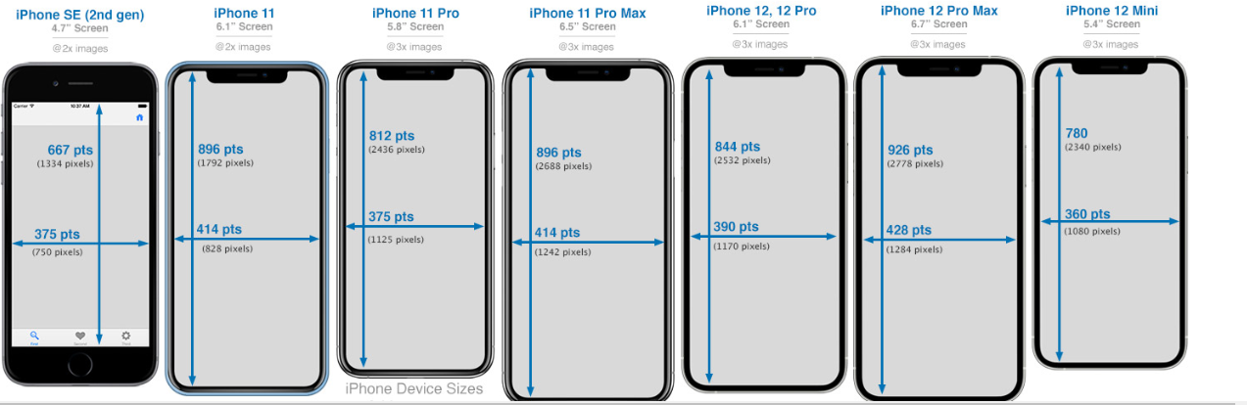
Taming images

Slide 19
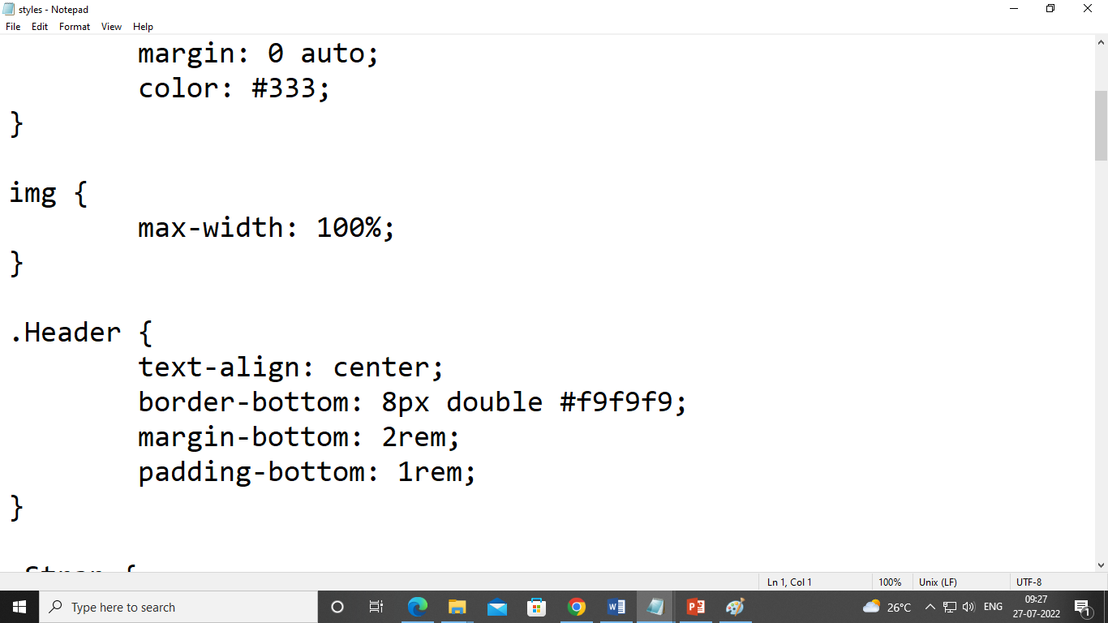
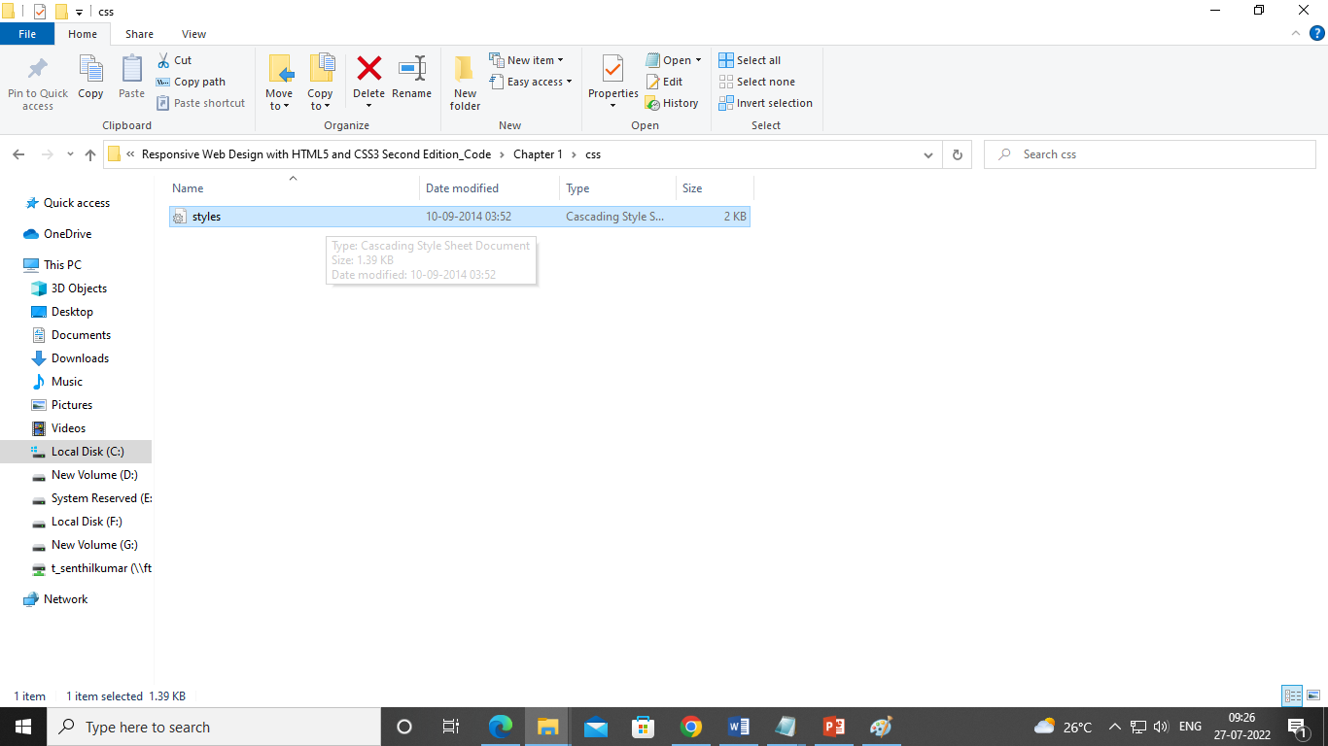
css/styles.css
All this max-width based rule does is stipulate that all images should be a maximum of 100% of their width (in that they should expand to 100% of their size and no more).
Where a containing element (such as the body or a div it sits within) is less than the intrinsic width of the image, it will simply scale up to the maximum available space.

Slide 20
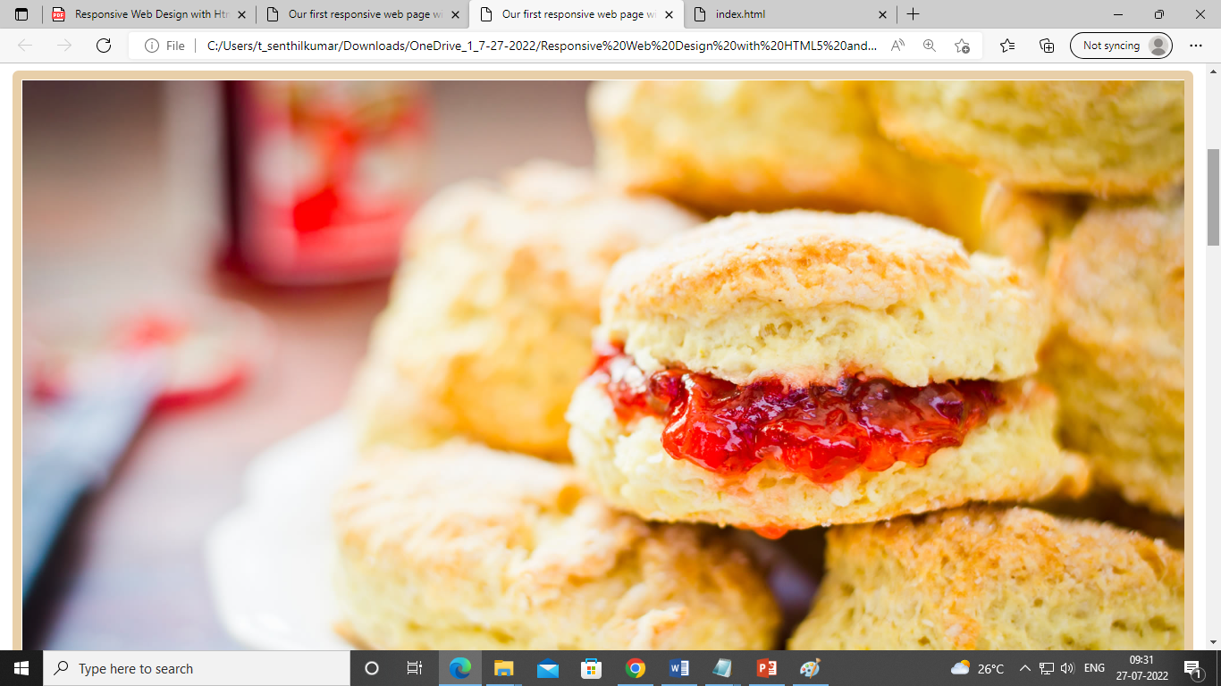
Large Viewports-- Maybe resize the image and position it off to one side(beyond 600px) Solution--- media queries

Slide 21
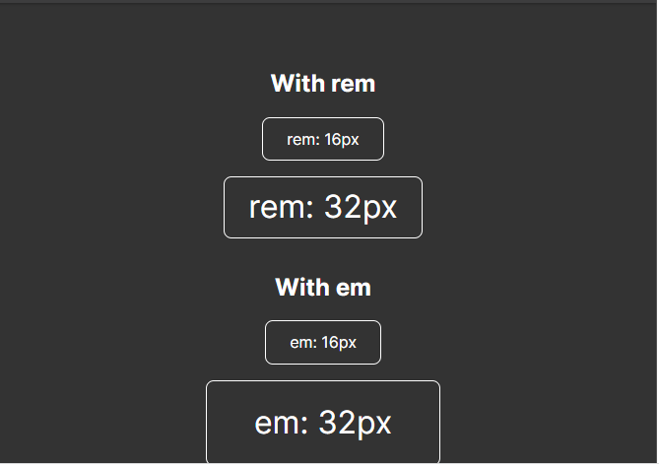
Breakpoints---Device widths
Making use of media queries it was common to see breakpoints in designs built specifically around the popular devices of the day.
At the time it was typically iPhone (320px x 480px) and iPad (768px x 1024px) that defined these 'breakpoints'.
let the content and the design itself determine where a breakpoint is relevant
CSS rules within this type of media query only get applied if the viewport is a minimum defined width.
The exact minimum width can be specified using a raft of different length units including percent, em, rem, and px
Rem (root em) stands for "root element's font-size“
Em stands for "parent element's font-size“
PX: Pixels (px) are considered absolute units, although they are relative to the DPI and resolution of the viewing device.
https://dev.to/theodorusclarence/back-to-basic-should-we-use-rem-em-or-pixel-1hd0#:~:text=Margin%20for%20typography%20(%20rem%20)%20%2D,)%20%2D%20It%20is%20the%20root!

Slide 22
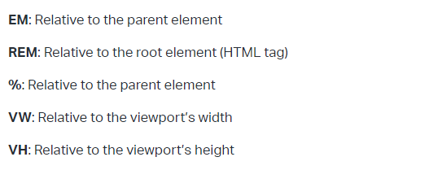
Refer:
https://elementor.com/help/whats-the-difference-between-px-em-rem-vw-and-vh/

Slide 23
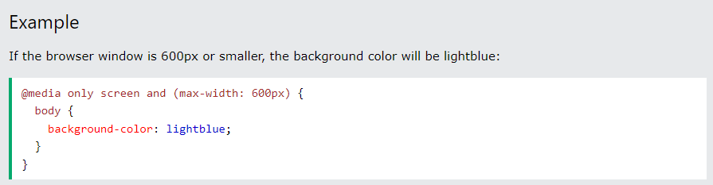
Media Query
Media query is a CSS technique introduced in CSS3.
It uses the @media rule to include a block of CSS properties only if a certain condition is true.

Slide 24
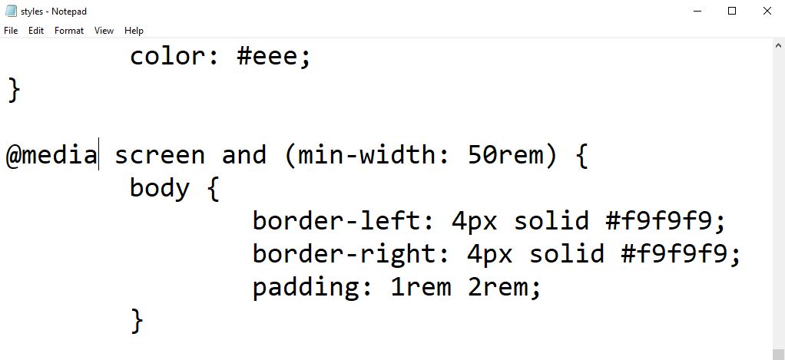
The @media directive tells the browser we are starting a media query, the screen part
It tells the browser these rules should be applied to all screen types and the and (min-width: 50em) tells the browser that the rules should be limited to all viewports above 50em of size.

Slide 25
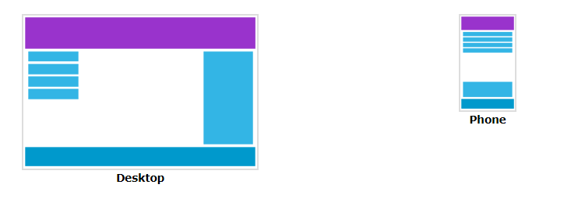
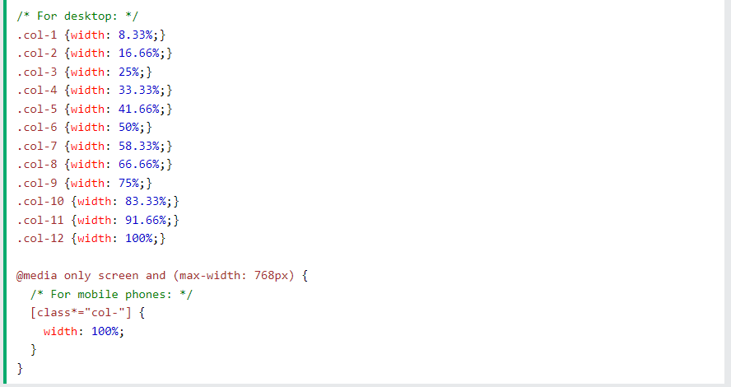
When the screen (browser window) gets
smaller than 768px, each column should
have a width of 100%:
Tryit Editor v3.7 (w3schools.com)

Slide 26
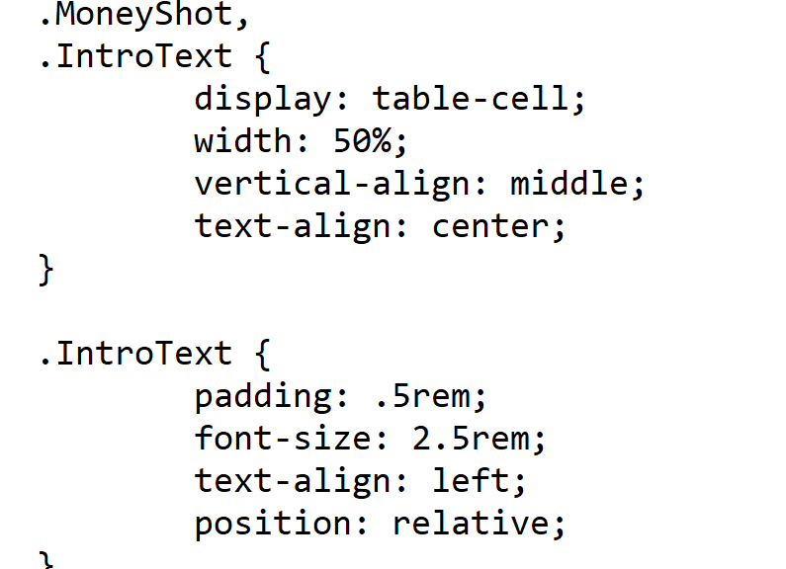
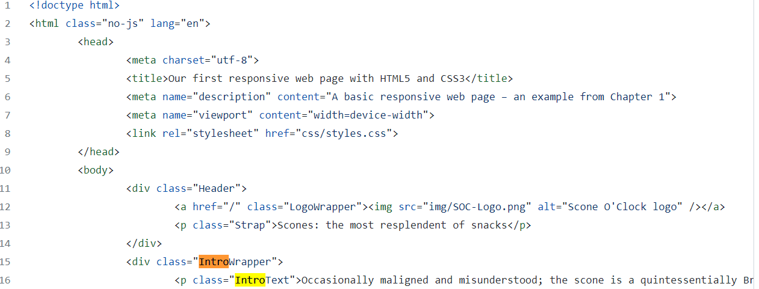
Fitting to larger screens

Slide 27
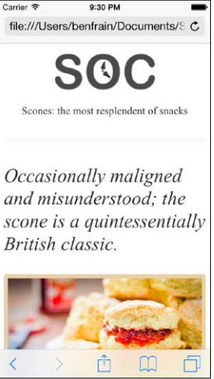
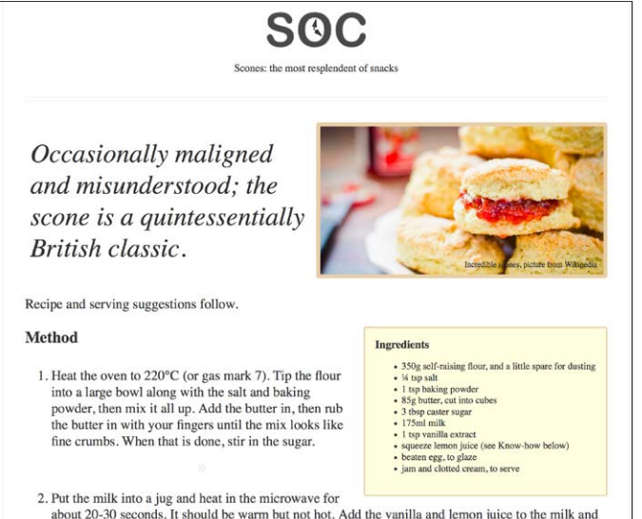

Slide 28
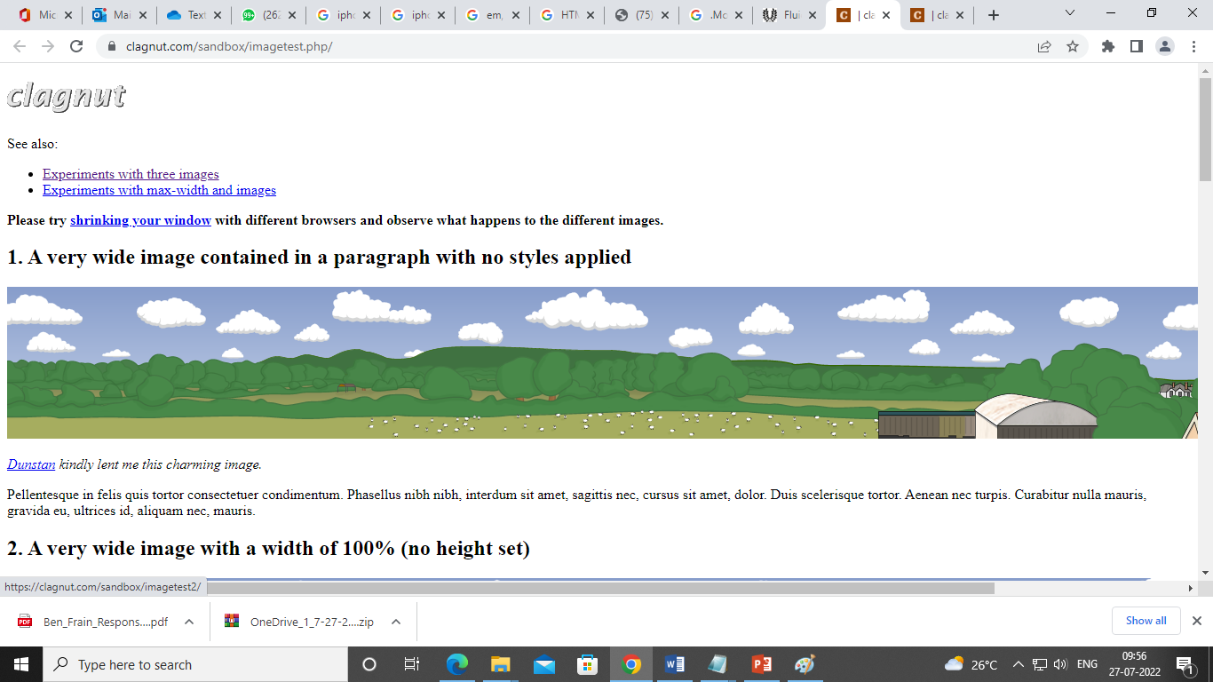
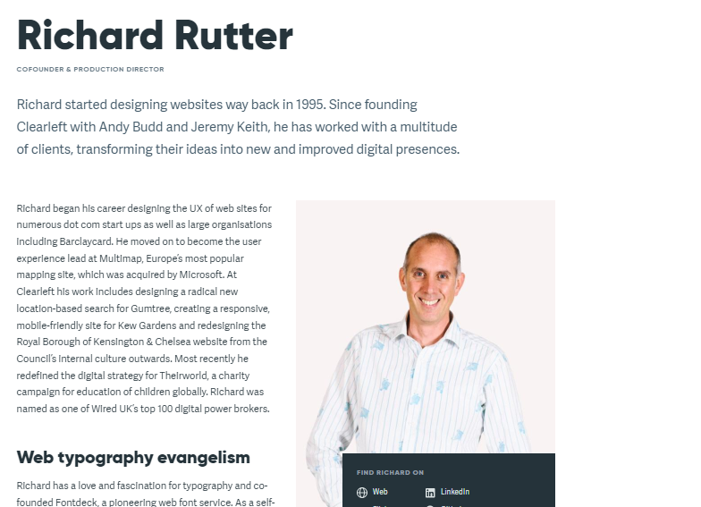
Fluid image
Responsive Web Design Images (w3schools.com)
https://clagnut.com/sandbox/imagetest.php/

Slide 29
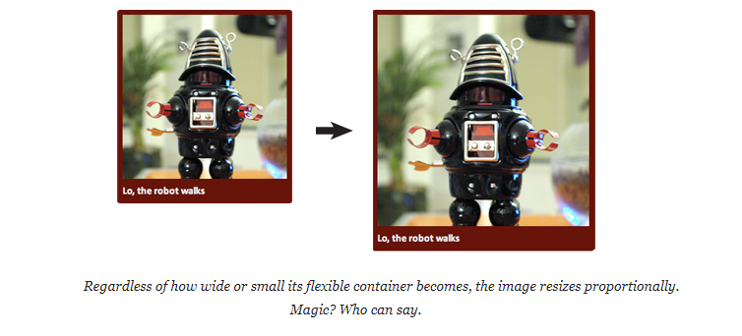
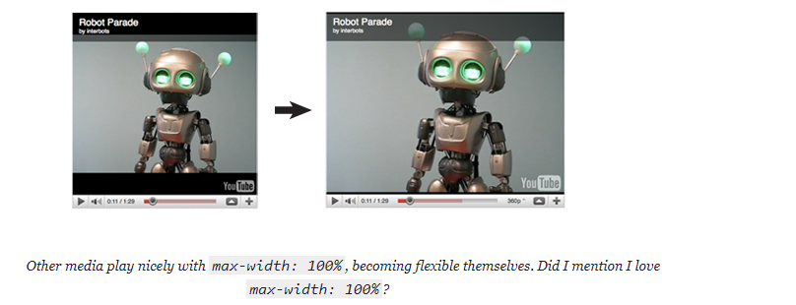
https://alistapart.com/article/fluid-images/

Slide 30
Let’s improve the design !!!
Session 3!!
Media Queries – Supporting Differing Viewports
What about under different light conditions?
What about changing the size of links when people use different pointing devices (a finger rather than a mouse for example)?
What about being able to animate and move visual elements simply, using nothing but CSS?
How do go about marking up pages with more semantic elements; article, section, menu, and the like, or make forms with built in validation (no JavaScript needed)?
If we want to change the visual order of elements at different viewports?
how can Fluid Images be handled?
How can logos and icons be handled ?

